Slide 1

Don't Write Secure Code! a (Build secure systems instead)
Seth Petry-Johnson
Notes:
Hello, and welcome to “Don’t Write Secure Code”. I’m Seth Petry-Johnson, and unlike some of the other speakers in this track, I am not a security professional. I’m just a normal programmer, although I do have a security related confession to make.

Slide 2
I hate writing secure code
Notes:
That confession is that I hate writing secure code.
Not proud of it, but when building a feature and elbow deep in complex business logic or functional requirements, I don’t want to think about security.
Want to be totally focused on biz problem, but ever-present security issues keep stealing focus.
User has to be logged in to do this. Have to have some permission to do that. Alice shouldn’t be able to see Bob’s data. … yadda
Constant need to pay attention to those same security concerns, over and over, feature after feature, bums me out.
So, maybe a better way of expressing myself is that

Slide 3
I hate writing secure code I hate writing secure feature code
Notes:
I hate writing secure feature code.
Actually don’t mind thinking about security, enjoy making system secure, just want to separate security code from features.
Want features to be clean / simple / elegant, not sullied up with a bunch of duplicate security checks copied and pasted between features.
So I guess what I’m really trying to say is that

Slide 4
I hate writing secure code I hate writing secure features I hate implementing cross-cutting security concerns by repeating the same patterns over and over again in my feature-level code
Notes:
Hate implementing cross-cutting security concerns by repeating the same patterns over and over again in my feature-level code.
That’s mouthful, but it’s exactly what this talk is all about. Because I hate doing this, I’ve invested time and energy looking for ways to avoid it.
Way I typically avoid it is by extracting security code into some part of my application framework so that it can be automatically applied across all features. This lets me keep brain in “feature mode”, keeps my feature code clean, and I still get to deliver secure system.
Over next 55 minutes going to share techniques with you. I want you to recognize intermingling of security & feature code in your systems, and give you tools for decoupling them so that you can maximize both security AND maintainability.

Slide 5
What's on the agenda?
Define "cross cutting" security concerns
Notes:
Here’s our agenda:
First I’ll define what it means for something to be a “cross cutting” security concern and what types of things are best suited to pushed into the framework.

Slide 6
What's on the agenda?
Define "cross cutting" security concerns
"Secure by default" examples
Notes:
Second, going to show you some examples of cross-cutting concerns that you can 100% completely solve in your framework code, without requiring any changes to your feature code.
Call this being “secure by default” b/c once these things are in place, it takes literally zero effort for developers to ship secure features.
If you're familiar with the phrase "pit of success", then that applies here because it actually takes more effort to be INSECURE than secure.

Slide 7
What's on the agenda?
Define "cross cutting" security concerns
"Secure by default" examples
Declarative vs Imperative security
Notes:
Unfortunately, not everything can be made fully secure by default, and sometimes you’ll still need to put some sort of security code into your features. I’ll show you how a declarative approach results in better factored code that minimizes the intermingling of concerns.

Slide 8
What's on the agenda?
Define "cross cutting" security concerns
"Secure by default" examples
Declarative vs Imperative security
Audit / Testing
Notes:
Finally, I’ll show you some ways that you can use static analysis tools to perform a security audit, and how you could incorporate that audit into your automated testing process.
Code samples in this talk are in .NET and JS, because that’s what I’m familiar with. However, many of the techniques I’ll show you have parallels in other languages and platforms as well, so the general ideas should be portable even if the specific code samples are not.

Slide 9
Application "framework"
Any code that leverages "hooks"
in the underlying system
Notes:
The main point of this talk is the idea of pulling cross cutting concerns out of your feature code and pushing them down into your framework.
Before I show any code, let me define those terms a little better.
When I talk about “framework level code”, referring to any code that leverages hooks in an underlying system or library so that it can be automatically executed at a specific time.

Slide 10
What framework stuff can I tap into?
MVC ActionFilter attributes (OnActionExecuting)
ASP.NET HTTP Modules
jQuery AJAX events (ajaxStart, ajaxEnd,etc)
ORM interceptors (connection opened)
Notes:
For example, ASPNET MVC lets you tap into the MVC pipeline w/ Action Filter.
ASP.Net HTTP Modules let you tap into the entire ASPNET request pipeline
jQuery lets you tap into AJAX request pipeline using global event handlers.
ORMs like EF & NH let you run code whenever a database connection is opened or transaction begins.
And if you need hook that doesn’t already exist, tools like PostSharp let you create your own. We’ll talk about this in a bit.
And of course, your custom application code might provide own framework level hooks. For instance, if you have some base class that everything derives from, then you can provide your extension points that make sense in your own system.
Basically, when I say “framework code”, I’m referring to something that you write that gets executed automatically by some underlying system, as opposed to the specific feature-level code you write at the top of your stack.

Slide 11
"Cross cutting" concern
Any security requirement that
spans multiple features
Notes:
When I say “cross cutting concern”, I’m referring to any security requirement that spans multiple features.
Cross cutting concerns can be low level & unrelated to your business domain, such as SQL injection.
Higher level requirements can be cross-cutting as well. You might have group of related pages or features that share permission requirement or access control strategy.
In both cases, the point is that separating cross-cutting concerns from feature or page-specific concerns makes code easier to maintain and your system more secure.
To illustrate this, I used my world-class Visio skills to bring you this example.

Slide 12

"Cross cutting" concerns
Security Requirements:
User must be logged in
Users only see their own Orders…
… unless they have "Manage Orders" permission, and can see everything
Notes:
This beautiful green square represents a feature on our website. It’s the “Order List” feature that displays to a user the list of orders that user is allowed to see.
Page has three requirements:
1) user must be logged in to see the page. 2) users can only see their own data, 3) Unless they have a specific permission that grants them access to all records

Slide 13
"Cross cutting" concerns
Security Requirements:
User must be logged in
Users with the "Manage Orders" permission see all Orders
Everyone else sees only their own Orders
Notes:
The naïve approach is to implement those requirements directly within the feature code.
This beautiful red square represents the security code being intermingled with the feature code.
If this was an MVC app, for instance, this red square might represent a couple of lines of code in the body of a controller action.

Slide 14
"Cross cutting" concerns
Notes:
The next feature we build is the Order Detail page so that the user can click on an Order and get more information about it. This page probably has the exact same security requirements for obvious reasons.
For the sake of this example, let’s assume those requirements are implemented exactly the same way on this feature as the first one.

Slide 15
"Cross cutting" concerns
Notes:
Next we build a feature to Cancel the order.
This feature should have same requirements as the first two, but maybe it was built by a different developer that wasn’t security conscious or was under some deadline pressure.
For whatever reason, this feature isn't secure at all.

Slide 16
"Cross cutting" concerns
Notes:
Finally, we build 4th feature to Refund the order. Again same requirements as other features, but maybe dev was unfamiliar with those implementations and they implement the same rules, but in a different manner. Maybe instead of doing check in controller action, they move into model or something. Red diamond represents the same basic rules, but implemented in a different way.
Problems with this approach might be obvious.
1 of these 4 features is insecure. If QA primarily tests through the UI, then as long as List & Detail page implement the rules, they might never discover that the Cancel feature allows anonymous access. With this architecture, only way to guarantee QA would find issue is via exhaustive, black-box testing of every rule against every endpoint
Maintaining the security code will be difficult. What happens when we add a new user role…

Slide 17
"Cross cutting" concerns
Notes:
If dev making the change doesn’t realize same rules are duplicated in other features, might end up changing just one of them. Now we have three implementations: triangle, square, and diamond.
Even if dev does replace all places using the “square” impl, might still miss Cancel feature w/ no security and Refund feature w/ “diamond” impl.
This is how security defects creep into software. Well-meaning developers either forget to implement a security check, or they inconsistently maintain security checks over time. Either way, we end up with a confusing and inconsistent mess of security code intermingled with feature code, or missing altogether.

Slide 18
"Cross cutting" concerns
Notes:
My approach would be to extract those business rules into something reusable so that we can implement the requirements only once.
There’s multiple ways that you could do this.

Slide 19
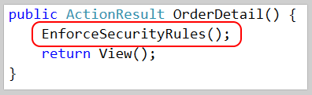
"Cross cutting" concerns
Notes:
The simplest would be to extract this logic into a helper method and call it from all 4 controller actions or something.
This would standardize on a single “square” implementation, but nothing prevents a developer from forgetting to call this method and leaving the feature insecure.
And again, the only way to guarantee that we'll find those insecure features, is if we're doing black-box testing of every single endpoint against the security requirements.

Slide 20
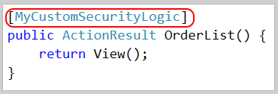
"Cross cutting" concerns
Notes:
Another approach would be to extract the logic into some sort of attribute that injects that logic into the appropriate part of the processing pipeline.
This also results in a consistent implementation, but it’s just as easy for a developer to forget. However, this approach is easier to audit. In a little bit I’ll talk about using static analysis to generate a report of secure and insecure endpoints based on attribute usage.

Slide 21

"Cross cutting" concerns
Notes:
In a perfect world, the developer wouldn’t have to do anything at all except write their business logic, and the security stuff would be handled automagically and in a way that was easily audited and tested. And that’s the point of this talk.
It isn’t always possible to get it quite this magical, but we can probably get a lot closer than you’d expect.

Slide 22
Show me the codez! bit.ly/DontWriteSecureCode
Notes:
For the rest of this talk I’ll be showing you a bunch of code samples from a demo app I wrote. This app, which you can get from my Github page, shows the same features implemented three ways: first, with no security at all, then using “secure feature” code where the security requirement is handled directly within the business logic, and finally with the security concerns extracted into some part of the framework.
I will move through my slides pretty quickly, but everything you’ll see up here comes straight from that project that you can reference later. It’s fully functional and heavily commented so I hope it’s a useful resource for you.
To start, I’m going to show you 3 examples of what I call a “secure by default” system. Each of these examples demonstrates how you can solve a problem once, and then more or less forget about it. Once it’s been solved in the framework, no additional developer effort is needed on a feature-by-feature basis.

Slide 23
Cross Site Request Forgery Fun fact*: users never log out. Ever.
* Not actually a fact.
Notes:
My first example deals with #8 on the OWASP Top 10, Cross Site Request Forgery. In case you’re not familiar with CSRF, here’s a quick overview.

Slide 24
Cross Site Request Forgery (CSRF)
Notes:
First, a user logs into a site they trust, such as their bank.
Second, while the session with the bank is active, they visit a malicious website. This could be in a different tab but it doesn’t have to be.
Third, the bad guy website tricks the user into submitting a form post TO the bank’s website, for example to the “transfer money” endpoint. If the bank website hasn’t been properly secured, all it’s going to see is a request coming in, from a logged in user with a valid session, requesting a fund transfer into the bad guy’s account.
In order to protect itself from this sort of thing, the bank needs a way to differentiate between a form post that initiated from its own domain versus a post that initiated from the bad guy’s website. The HTTP Referrer can help with this, but it’s insufficient on its own because that value is spoofable.

Slide 25
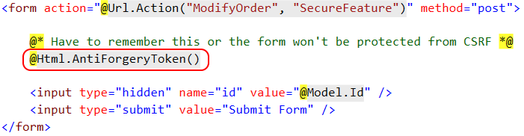
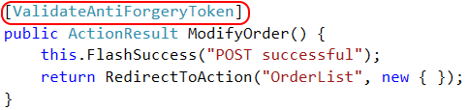
CSRF Defense – feature
Notes:
ASP.NET gives us tools to protect against CSRF. You have to do 2 things: call helper inside body of form, & add ValidateAntiForgeryToken attribute to the action.
The helper does three things. (1) creates a cryptographic token, (2) emits hidden form field, (3) creates cookie.
When form is submitted, the attribute compares the value in the form body against the cookie value and rejects the post if they don't match.
Browser’s security model prevents the bad guy website from reading or writing the cookies for the friendly site, so only way the tokens will match is if the form being submitted is coming from the friendly site itself.
Easy to do, but not secure by default. Requires dev to make corresponding changes in two files. And if dev remembers helper, but forgets the attribute, form post will be accepted. Dev might think they’re secure, but actually vulnerable.
Also, this only works if you’re submitting a form. This helper doesn’t really help if you’re doing an AJAX post because there’s no form to write the hidden field into.

Slide 26

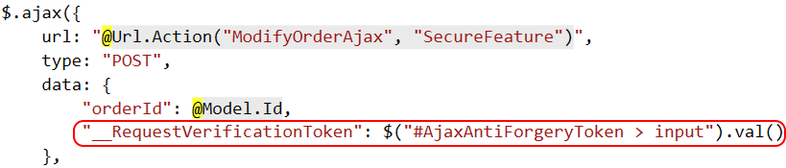
CSRF Defense – feature (ajax)
Notes:
If you’re making an AJAX form post, you have to do something like create a div, call the helper to create the hidden form field, and then manually copy that hidden form field value into your AJAX payload.
This really sucks. It’s ugly, it’s error prone, and it’s not a pattern that I want to be repeating every single time I need to make an AJAX post.

Slide 27
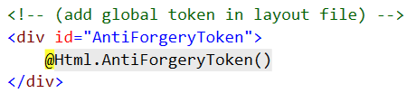
CSRF Defense – cross cutting
Notes:
To handle this in a cross-cutting way we need to do a few things.
First, we need to create one, global anti-CSRF token. I do this in my global layout file so that it applies to every page on my site. Remember that this creates a hidden text field AND creates a cookie.

Slide 28
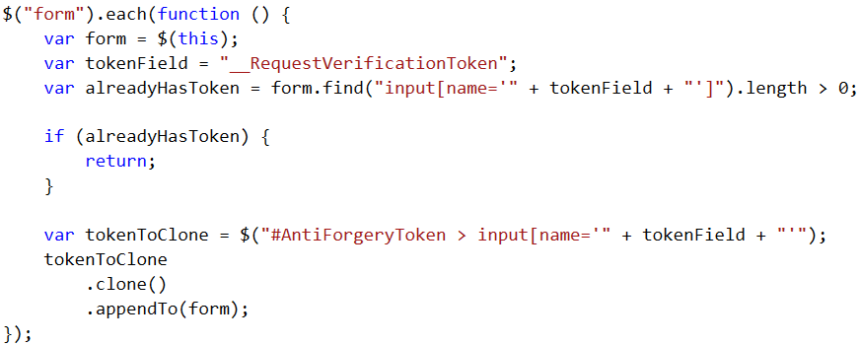
CSRF Defense – cross cutting
Notes:
Second, on document ready I run a tiny bit of jQuery that loops through every form on the page, looks to see if it already has a token field, and if not, clones the global one and adds it to the form.
This ensures that every single form that I use on my site will end up with a hidden field containing that security token.

Slide 29
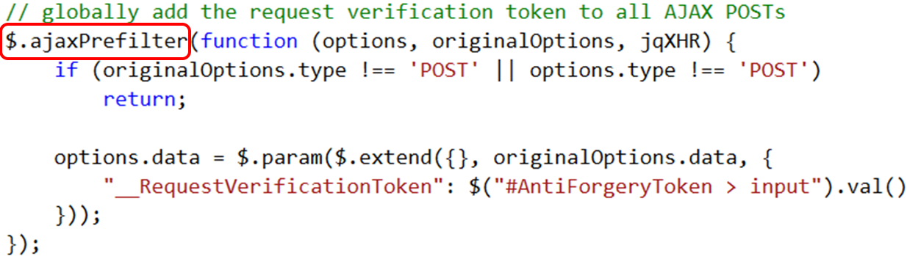
CSRF Defense – cross cutting
Notes:
To handle AJAX posts, I run a second bit of JQuery that defines a global jquery “ajax prefilter” handler.
Hooking into the prefilter event lets you can modify the AJAX options before the request is sent. In this case, I add that CSRF token to every single AJAX POST.

Slide 30
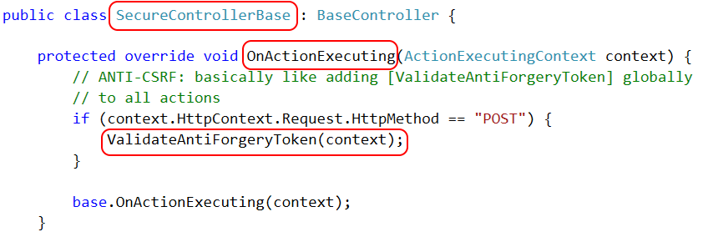
CSRF Defense – cross cutting
Notes:
Finally, we need to run the token validation logic automatically for all form post actions. We can do that by creating a custom controller class and overriding the OnActionExecuting method. The code that we put here will run on every single request, so if that request is a form post then we run the token verification logic.
The only thing the developer has to do is derive their controller from the correct base class. As long as they do that, everything is handled automatically.

Slide 31

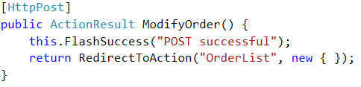
CSRF Defense – cross cutting
Notes:
Here’s what the feature level code looks like when we’re done. This is 100% business logic, and yet every single form post is still protected from cross site request forgery attacks.

Slide 32
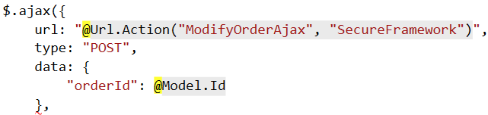
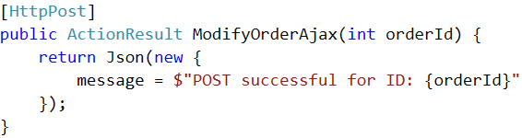
CSRF Defense – cross cutting (ajax)
Notes:
And here’s what it looks like for an AJAX POST. Again, it’s 100% business logic, yet still protected.
CSRF defense is a great example of a cross-cutting concern because it’s orthogonal to individual feature requirements, it applies globally to the whole system, and it’s pretty easy to make it “secure by default”.

Slide 33
Authentication Keeping out the unwashed masses
Notes:
My next example of making a feature “secure by default” deals with Authentication, or specifically with preventing anonymous access to protected areas of your site.
Most web frameworks make this fairly easy to do.

Slide 34
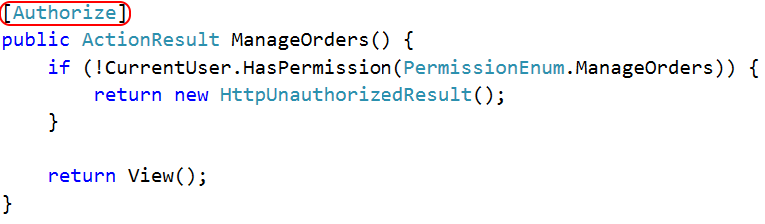
Authentication
Notes:
In ASPNET MVC, for instance, you can add the [Authorize] attribute to an Action and it will automatically redirect users to the login page if they aren’t logged in.
I don’t like using this though, because it represents a “public by default” model where any given MVC endpoint is accessible anonymously unless it is explicitly flagged as private. I tend to work on applications where the vast majority of resources are private, and only a specific few are public, so I want a “private by default” model instead.
One way to build a “private by default” model is to create a custom HTTP Module that runs on every request and enforces a login, unless the URL matches a whitelist of endpoints that allow anonymous access.
This is actually really easy to do.

Slide 35
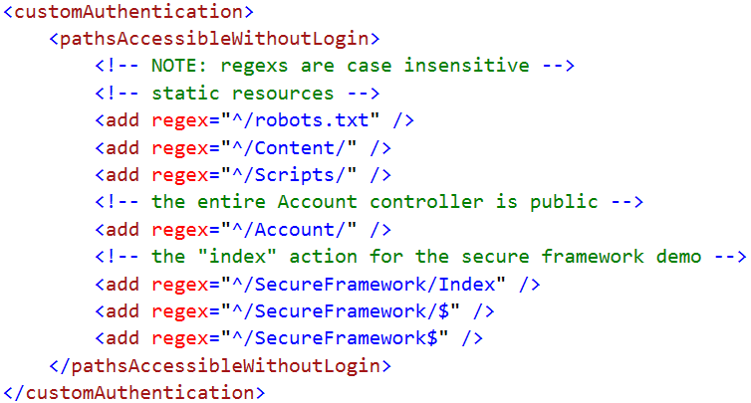
Authentication
Notes:
First, we need some place to manage that whitelist. Since our goal is to require zero changes to the feature code, I like to use a custom section of web.config to do this. That way I don’t need to make any changes at all to the controllers themselves.
Now, it’s important to note that HTTP Modules run for EVERY request, not just ones that get routed into MVC. That means that our whitelist needs to include static resources, such as stylesheets or scripts, that we want to use on our login page.
For that reason, I like to build my whitelist using regular expressions. That way I can create a single rule that grants access to my entire Scripts folder so that I don’t have to continually modify web.config each time we add a new jquery plugin.
Creating custom web config sections is pretty simple, but I don’t have time to show the code in this session so just check out my demo app to see how it works.

Slide 36
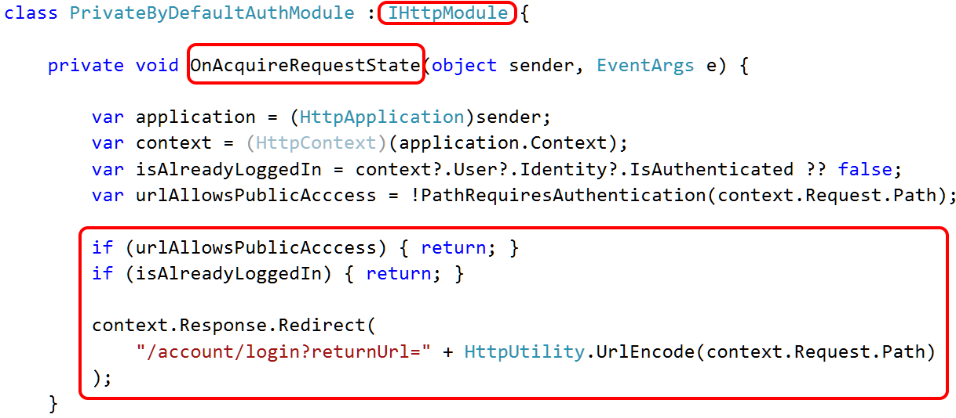
Authentication
Notes:
Once we’ve defined the whitelist, we need to create the HTTP module to enforce it.
This is also really easy to do. It’s just a class that implements the IHttpModule interface and then provides an implementation for this OnAcquireRequestState method.
In the body of this method we look to see whether or not the URL matches our whitelist and whether or not the user is already logged in. If either of those things are true then we do nothing. Otherwise, we send the user to the login page.

Slide 37
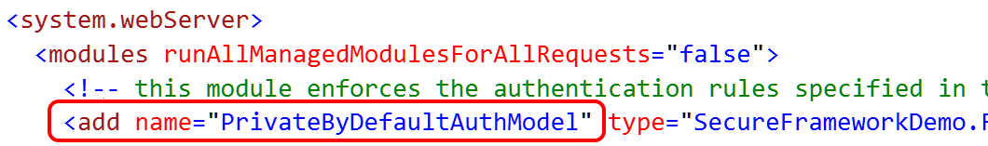
Authentication
Notes:
The last piece of the puzzle is to tell IIS to run that module for all requests, and we can do that with a single line of code in web.config.
And that’s it. Now, every single request that comes into my site will be automatically redirected to the login page unless the user is logged in, OR the URL matches a whitelist that I can control in a single, centralized place. The developers literally need to take zero additional effort to make their endpoints secure, and if they want to make something public it’s just a single adjustment to the whitelist.
Also, in the last segment of this talk, I’ll show you a way to generate a report of all of your MVC controller actions and whether or not they are publicly accessible. That sort of auditing is a useful way of validating that your whitelist is doing what you expect it do.

Slide 38
Access Control Keeping Bob's hands off Alice's data

Slide 39
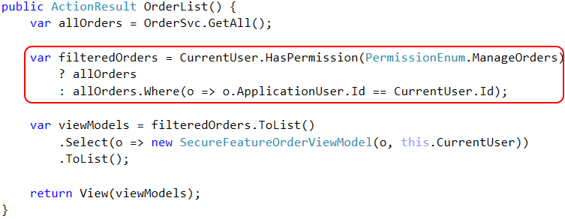
Access Control – feature

Slide 40
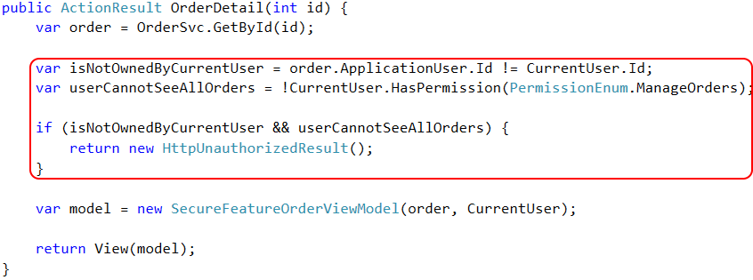
Access Control – feature

Slide 41
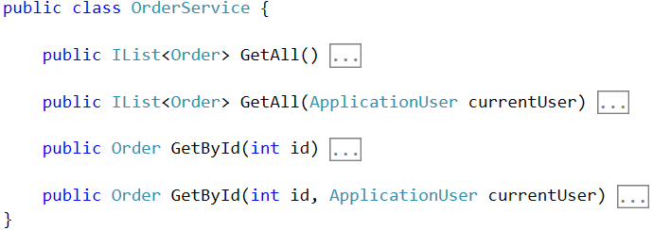
Access Control – framework

Slide 42
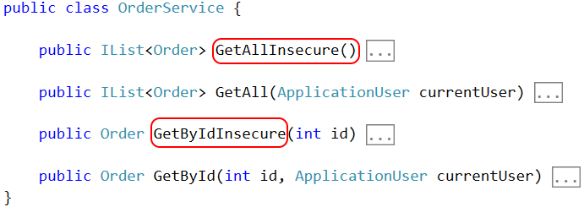
Access Control – framework

Slide 43
Access Control – Row Level Security

Slide 44
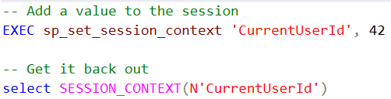

Access Control – Row Level Security

Slide 45
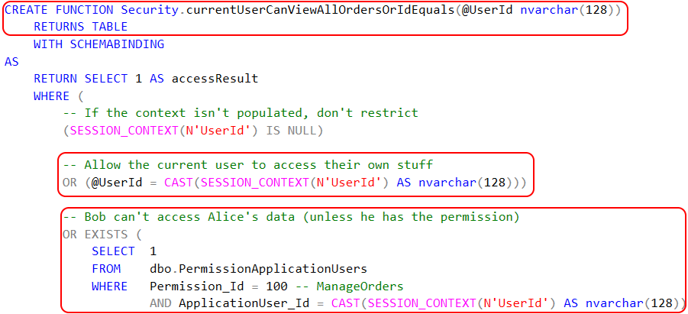
Access Control – Row Level Security

Slide 46

Access Control – Row Level Security

Slide 47
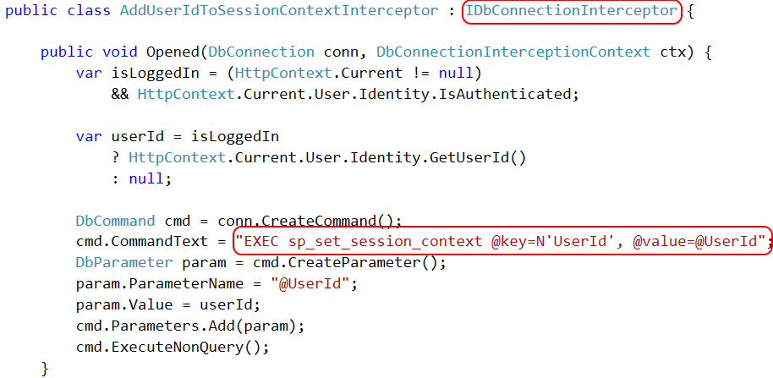
Access Control – Row Level Security

Slide 48
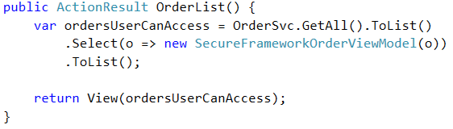
Access Control – framework

Slide 49
Page-level Authorization Keeping Bob in his sandbox

Slide 50
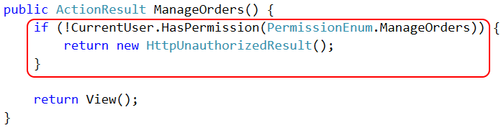
Page Authorization – feature

Slide 51
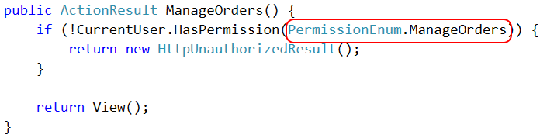
Page Authorization – feature

Slide 52

Page Authorization – cross cutting

Slide 53
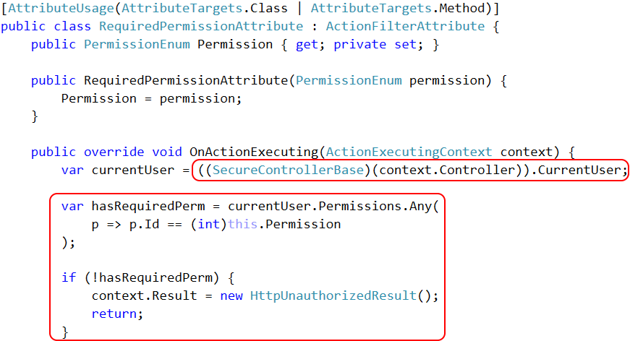

Slide 54
Property-level Authorization Keeping private data private!

Slide 55
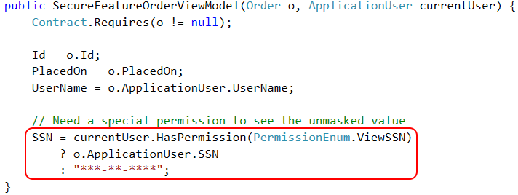
Property Authorization – feature

Slide 56
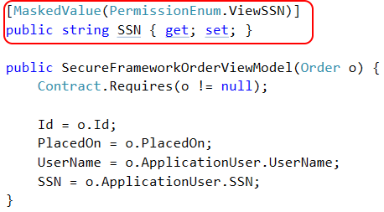
Property Authorization – cross cutting

Slide 57
Property Authorization – cross cutting

Slide 58
Property Authorization – cross cutting

Slide 59
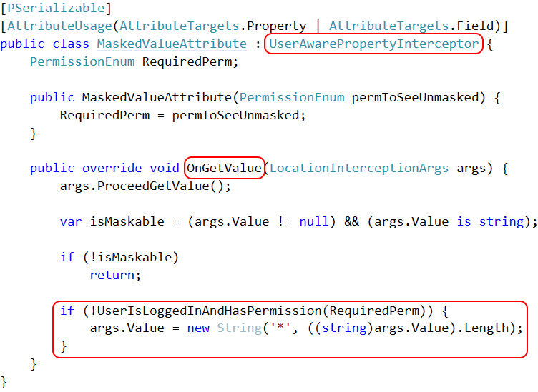

Slide 60
Property Authorization – cross cutting

Slide 61
Auditing and Testing Try this with your fancy dynamic language!

Slide 62
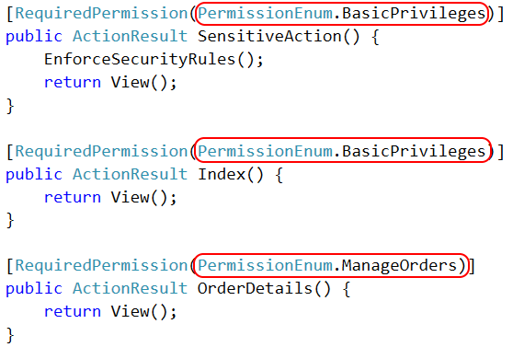
Authorization auditing

Slide 63
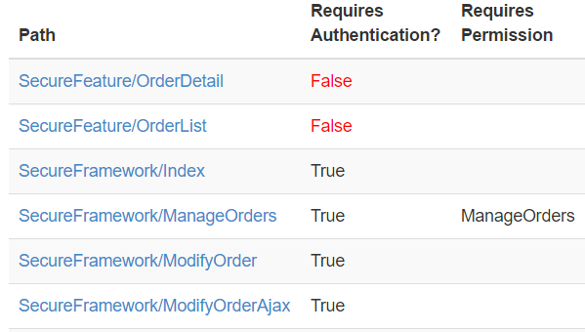
Authorization auditing

Slide 64
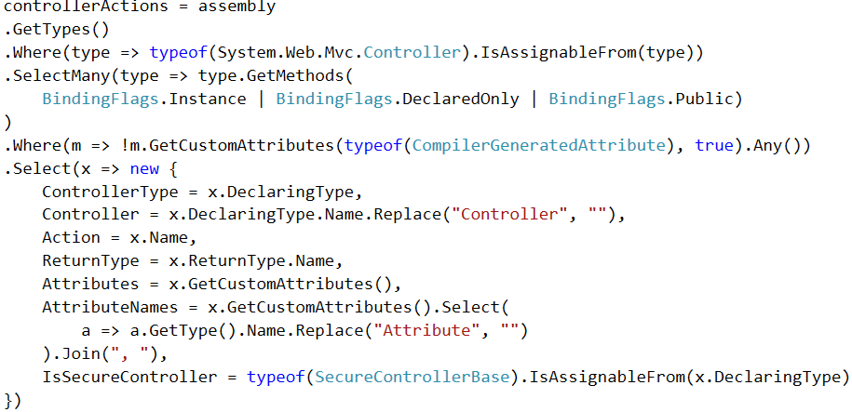
Authorization auditing

Slide 65
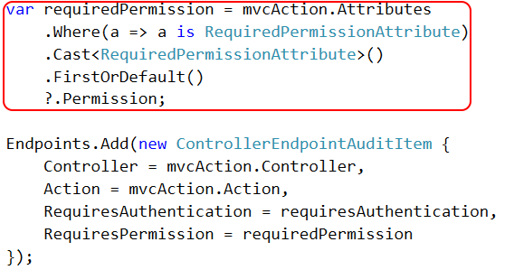
Authorization auditing

Slide 66
Authorization auditing

Slide 67

http://approvaltests.com

Slide 68
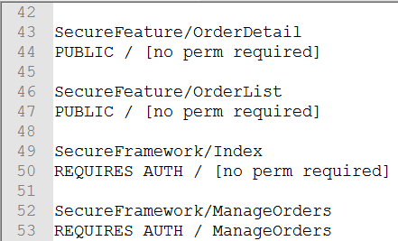
Approval Tests – Step 1

Slide 69
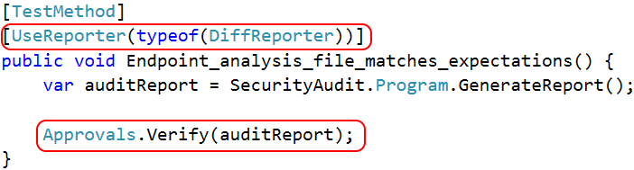
Approval Tests – Step 2

Slide 70
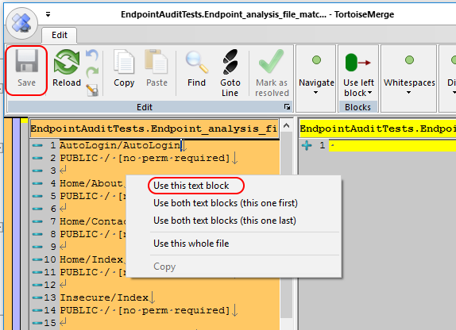
Approval Tests – Step 3

Slide 71
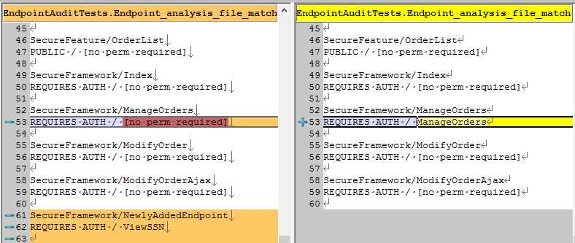
Approval Tests – Step 4

Slide 72
What makes auditing easier?
Using [Attributes] to decorate classes/methods
Inheriting a base class
Implementing an interface

Slide 73
Recap The CliffsNotes version

Slide 74
bit.ly/DontWriteSecureCode
Global CSRF defense
Private-by-default MVC controllers
Row level security in SQL Server 2016
Permission-based MVC attributes
Permission-based property access, with PostSharp
Auditing w/ reflection and Approval Tests
github.com/spetryjohnson | www.petry-johnson.com
@spetryjohnson

